Slide 1



InboxVoyager Project Website
a GMAIL client
INBOX VOYAGER
Presented by: Can Bulut - Tuna Özcan
Project Advisor: Assoc. Prof. Dr. Burkay GENÇ

Slide 2





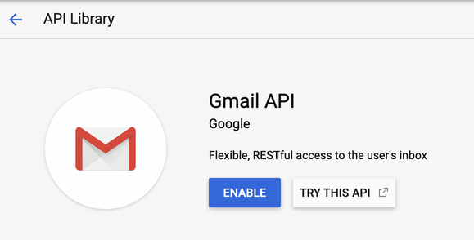
USED TECHNOLOGIES
DURING DEVELOPMENT
01
02
03
HTML
CSS
GOOGLE CLOUD SERVICES
04
05
06
JAVASCRIPT
XAMPP
GMAIL-API
JQUERY
a framework of .js

Slide 3
OVERVIEW
01
02
03
Problem Statement
What we offer to solve
Projected Benefits
04
05
06
Client Pages Overview
Our Methodology
Outcomes and Discussion

Slide 4





PROBLEM STATEMENT
TRADITIONAL GMAIL INTERFACES LEAD TO INFORMATION OVERLOAD AND EYE STRAIN FOR US,FOR REGULAR USERS, MAKING IT CHALLENGING TO NAVIGATE THROUGH INBOXES EFFICIENTLY
THIS INEFFICIENCY RESULTS IN WASTED TIME, INCREASED FRUSTRATION, AND COMPROMISED EYE HEALTH, LOWERING EFFECTIVE COMMUNICATION AND WORKFLOW

Slide 5

WHAT WE OFFER TO SOLVE
GOALS AND OBJECTIVES
Visualized Inboxes and Threads: Provided an interface that simplifies navigation through emails.
Dynamic Interface: Developed chat-like, interactive email threads for a more engaging user experience.
Streamlined Email Replies: Implemented quick reply buttons and templates to facilitate faster responses.

Slide 6





PROJECTED BENEFITS
01
Enhanced Productivity: Save time and reduce stress with streamlined email management.
02
Improved User Experience: Navigate emails more efficiently with visualized inboxes and interactive threads.
03
Healthier Digital Interaction: Minimize eye strain and visual clutter with hover functionality.
04
Effortless Communication Tracking: Track conversations effortlessly with the unique conversation timeline feature.

Slide 7



CLIENT PAGES OVERVIEW
and Unique Features - Use Cases

Slide 8
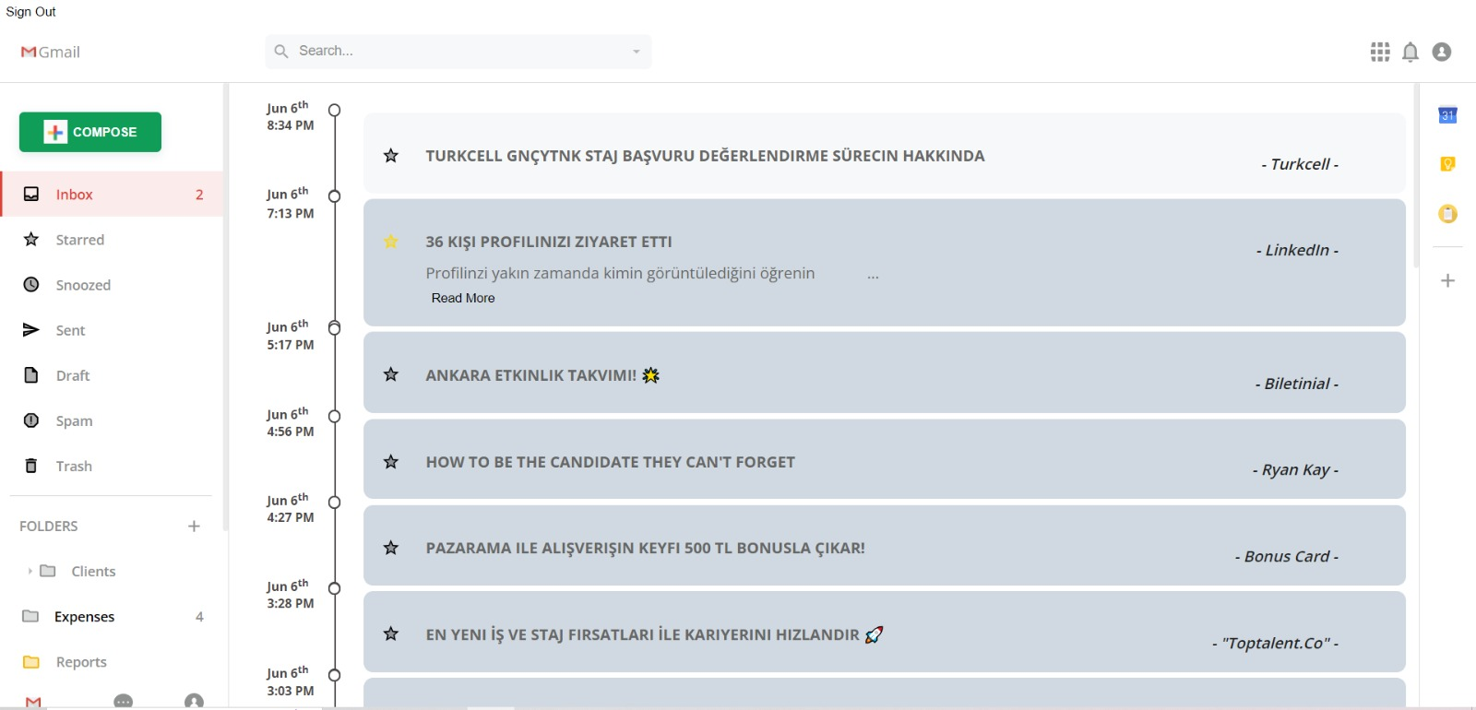
MAIN INBOX PAGE

Slide 9
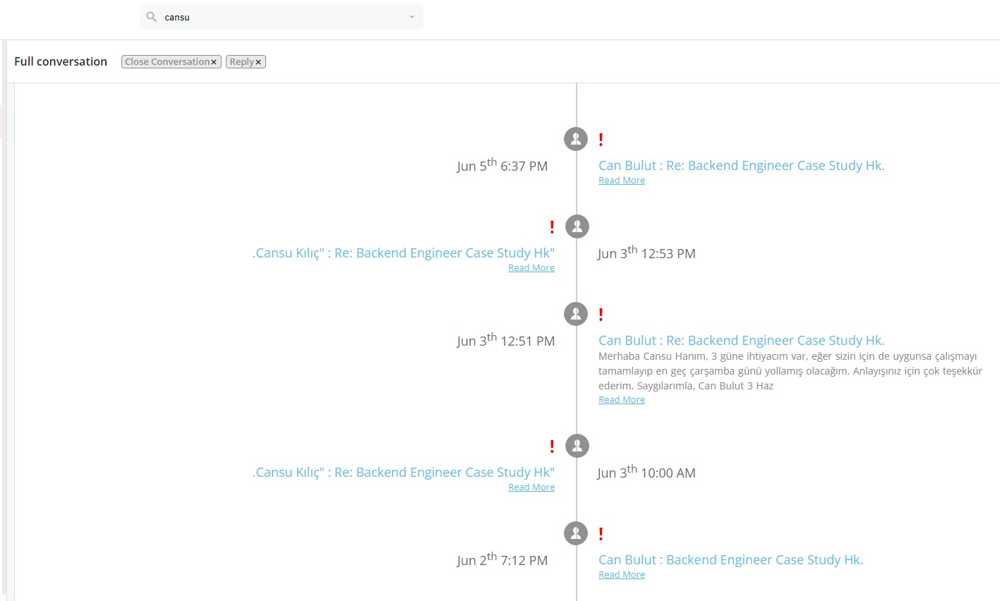
Conversation Timeline Page:

Slide 10
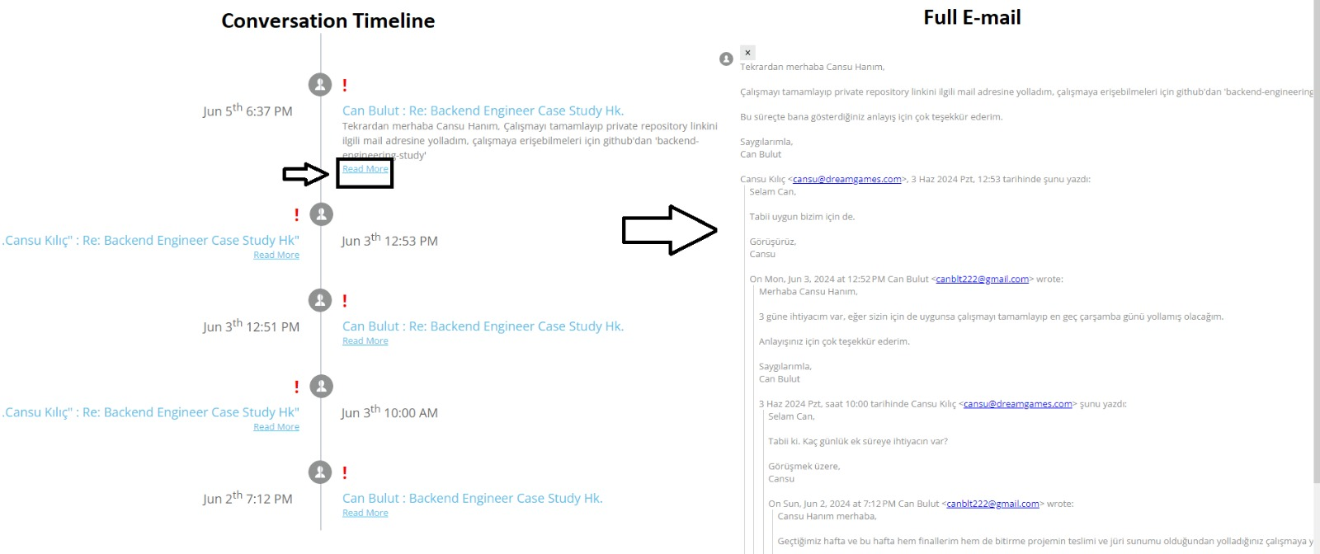
Read More Button:

Slide 11
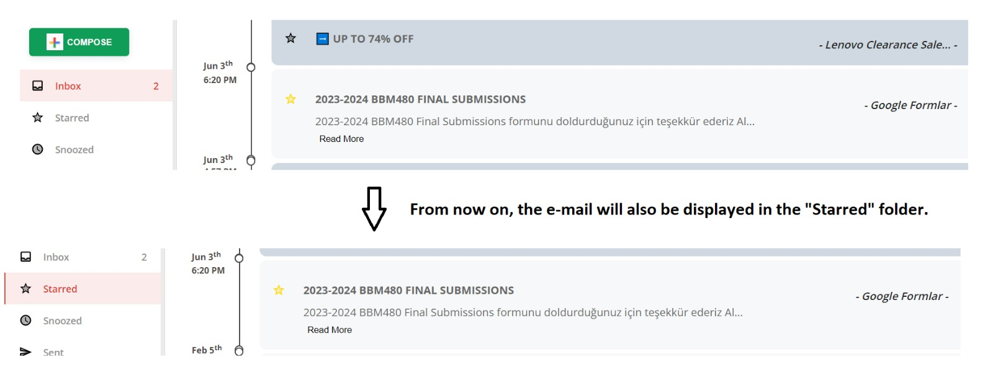
Starring an E-mail:

Slide 12
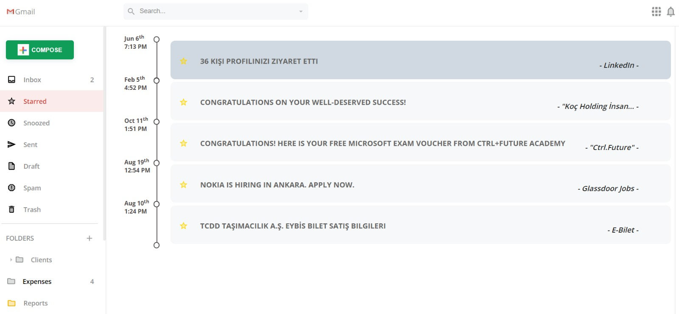
Starred Mails Folder:

Slide 13
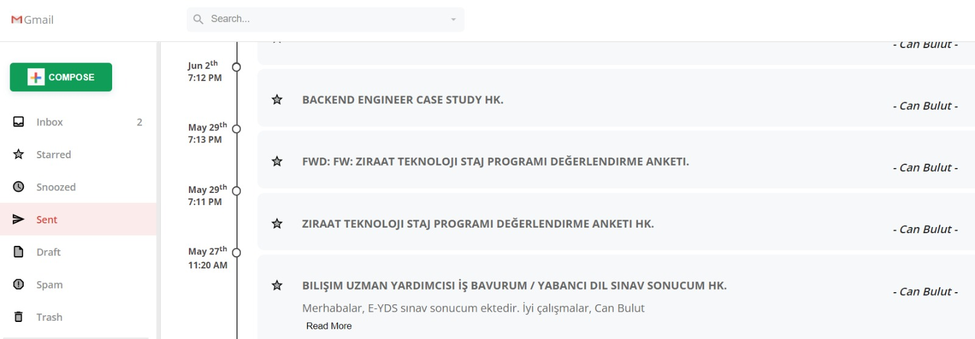
Sent Mails Folder:

Slide 14
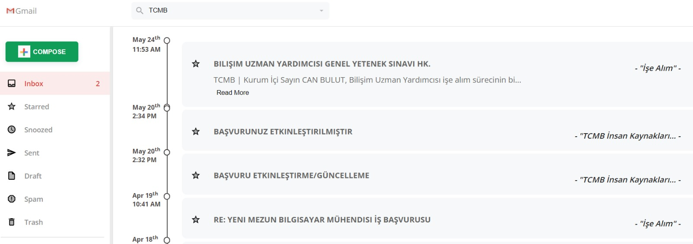
Search-Bar Functionality:

Slide 15
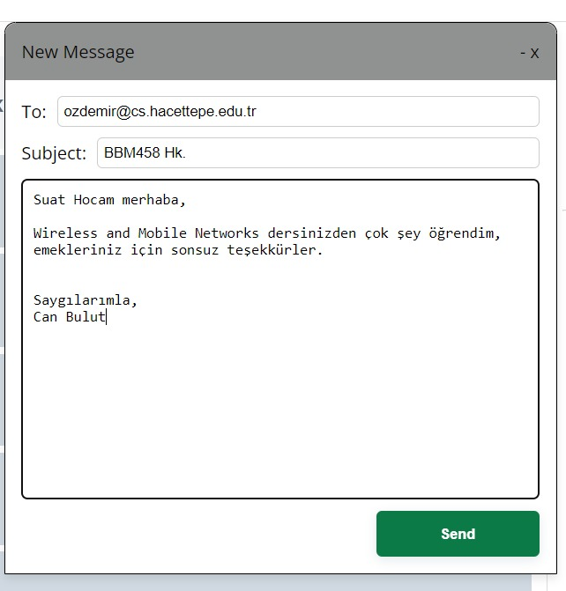
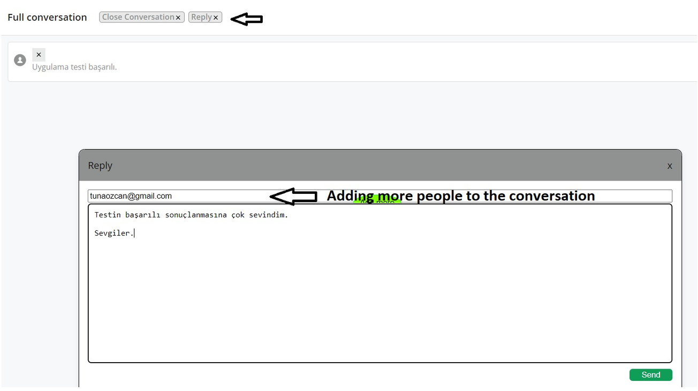
Composing an e-mail POP-UP:
Replying to an e-mail and adding more people to that conversation:

Slide 16
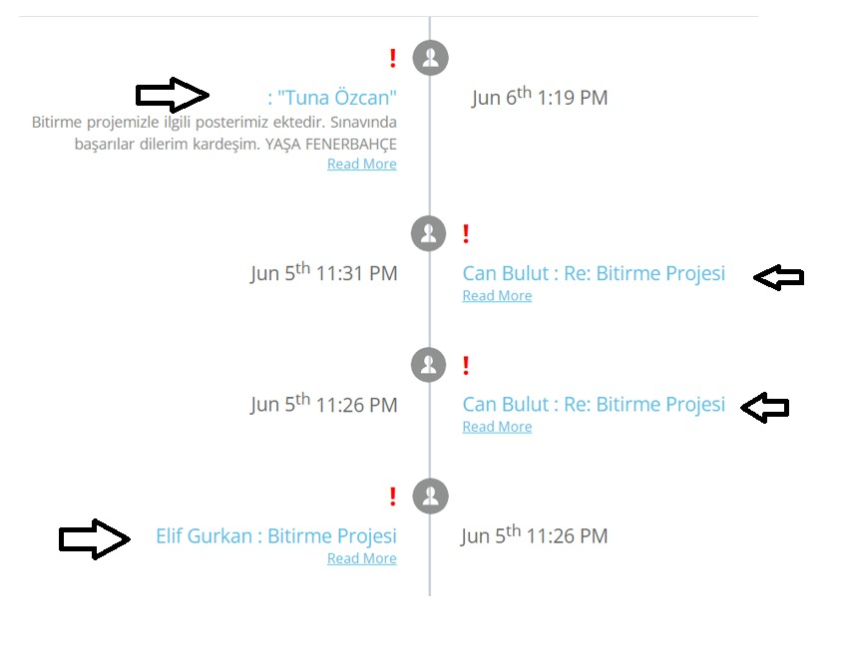
When a Conversation Involves More Than Two Participants:

Slide 17
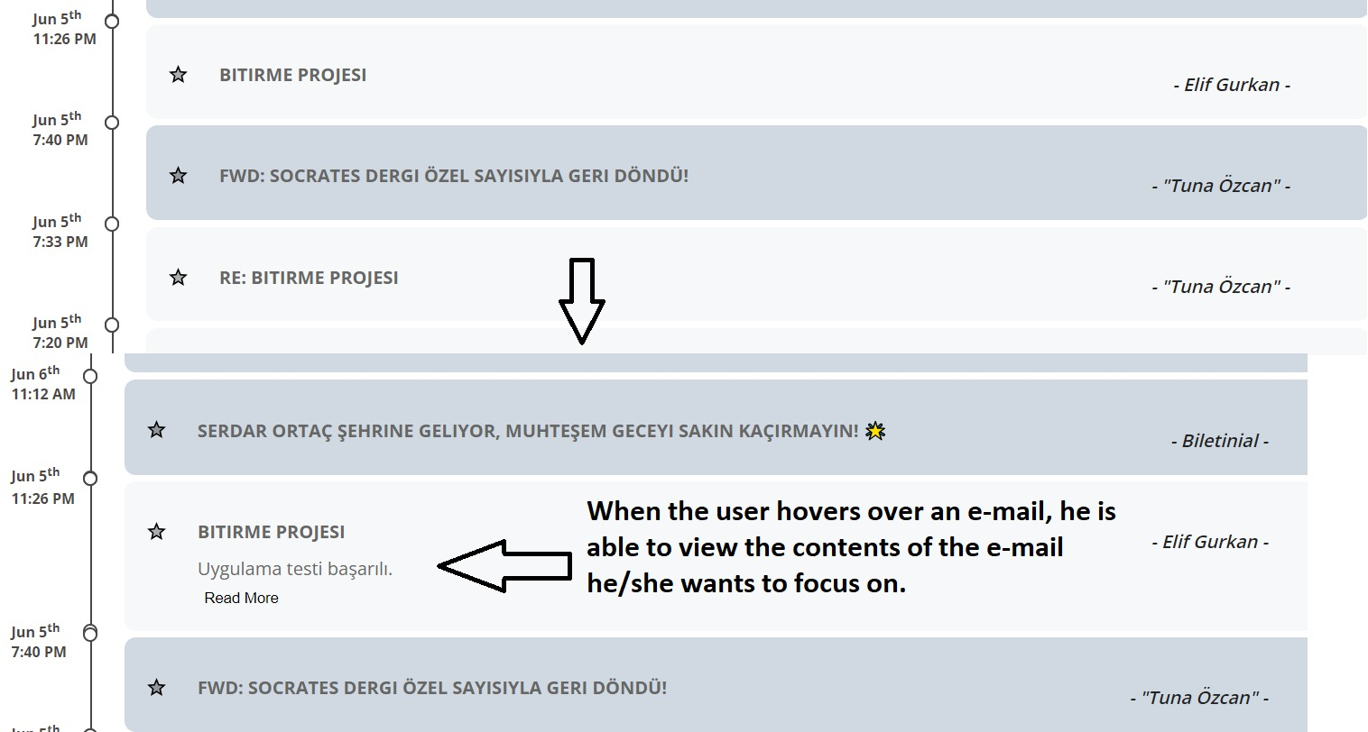
Hovering Over an E-mail:

Slide 18
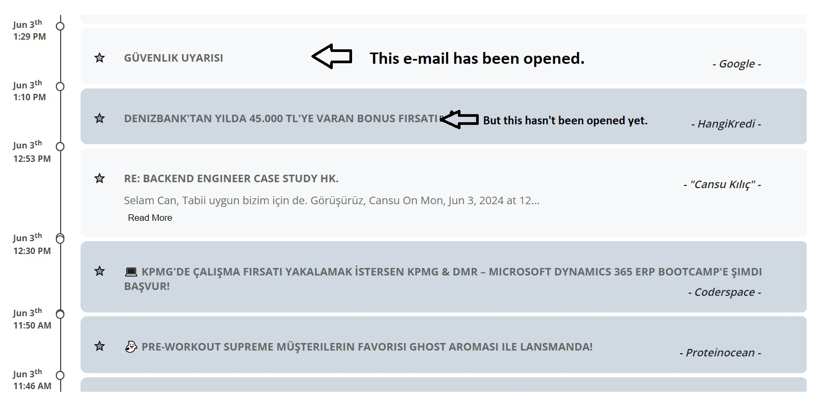
Difference Between a Read and Unread E-mails:

Slide 19





OUR METHODOLOGY DURING THIS PROJECT
Scrum Methodology:
Sprint Planning: We defined project goals and created a task backlogs.
Daily Stand-ups: Brief meetings (most ıf the time once or twice a week) to track progress and address new foundings.
Sprint Reviews: Evaluation of work, gathering feedback, and demonstratingincrements. Analyzing performance and identifying improvements.
How did we apply to Inbox Voyager?
We developed features iteratively in sprints.
We Integrated user feedback (our feedback as test users) to redefine the interface.
Of course we ensured continuous collaboration for timely delivery.

Slide 20





DISCUSSIONS AND OUTCOMES
Outcome 2: Enhanced User Experience
Outcome 1: Improved Email Navigation
Outcome 3: Streamlined Email Responses
Discussion: Traditional GMAIL clients often lead to information overload and inefficient navigation. Inbox Voyager's visualized inboxes and threads offer a more intuitive and streamlined interface.
Outcome: Users can quickly locate important emails and threads, reducing the time spent on email management.
Discussion: The chat-like, interactive email threads and hover functionality significantly improve user engagement and usability.
Outcome: This dynamic interface leads to a more pleasant and productive email experience, reducing eye strain and improving overall user satisfaction.
Discussion: Inbox Voyager's quick reply buttons and templates simplify the process of responding to emails.
Outcome: Users can handle their email replies more efficiently, leading to increased productivity and reduced response times.

Slide 21


DISCUSSIONS AND OUTCOMES (CONTD.)
Outcome 4: Effective Communication Tracking
Outcome 5: Healthier Digital Experience
Discussion: The unique conversation timeline feature ensures that emails involving multiple participants are organized chronologically.
Outcome: This innovation enhances communication by making it easier to track conversations and ensuring no messages are missed.
Discussion: By focusing on essential content and minimizing visual clutter, Inbox Voyager reduces eye strain and promotes a healthier digital experience.
Outcome: Users experience less eye fatigue, contributing to better long-term eye health and more comfortable email management.

Slide 22





OUR TEAM AND ADVISOR - REVISITED
Can Bulut
Tuna Özcan
Assoc. Prof. Dr. Burkay GENÇ
Linkedin Profile
Linkedin Profile
Project Advisor

Slide 23
RESOURCES AND REFERENCES
Google for Developers
InboxVoyager Project Website
Github Pages Documentation
https://tanitim.cs.hacettepe.edu.tr/
And special thanks to Canva

Slide 24


Thank's For Watching
Q & A
Do you have any additional questions?

